Slide 1
Applications of Information & Communication Technology
Mr. Ali Haider
Institute Of Management Sciences

Slide 2
Checkboxes
Checkboxes let a user select ZERO or MORE options of a limited number of choices.
<form>
<input type="checkbox" id="vehicle1" name="vehicle1" value="Bike">
<label for="vehicle1"> I have a bike</label><br>
<input type="checkbox" id="vehicle2" name="vehicle2" value="Car">
<label for="vehicle2"> I have a car</label><br>
<input type="checkbox" id="vehicle3" name="vehicle3" value="Boat">
<label for="vehicle3"> I have a boat</label>
</form>

Slide 3
<select> Element
The <select> element defines a drop-down list.
he <option> element defines an option that can be selected.
By default, the first item in the drop-down list is selected.
To define a pre-selected option, add the selected attribute to the option

Slide 4
<form>
<label for="cars">Choose a car:</label> <select id="cars" name="cars"> <option value="volvo” selected>Volvo</option> <option value="saab">Saab</option> <option value="fiat">Fiat</option> <option value="audi">Audi</option> </select>
</form>

Slide 5
<datalist> Element
The <datalist> element specifies a list of pre-defined options for an <input> element.
Users will see a drop-down list of the pre-defined options as they input data.
The list attribute of the <input> element, must refer to the id attribute of the <datalist> element.
<form>
<input list="browsers">
<datalist id="browsers">
<option value="Edge"> <option value="Firefox"> <option value="Chrome"> <option value="Opera"> <option value="Safari">
</datalist> </form>

Slide 6
<textarea> Element
The <textarea> element defines a multi-line input field (a text area).
The rows attribute specifies the visible number of lines in a text area.
The cols attribute specifies the visible width of a text area.
<textarea name="message" rows="10" cols="30">
The cat was playing in the garden.
</textarea>

Slide 7
Submit Button
The <input type="submit"> defines a button for submitting the form data to a form-handler.
The form-handler is typically a file on the server with a script for processing input data.
The form-handler is specified in the form's action attribute.

Slide 8
<form>
<label for="fname">First name:</label><br>
<input type="text" id="fname" name="fname" value="John"><br>
<label for="lname">Last name:</label><br>
<input type="text" id="lname" name="lname" value="Doe"><br><br>
<input type="submit" value="Submit">
</form>

Slide 9
<button> Element
The <button> element defines a clickable button:
<button type="button" onclick="alert('Hello World!')">Click Me!</button>

Slide 10
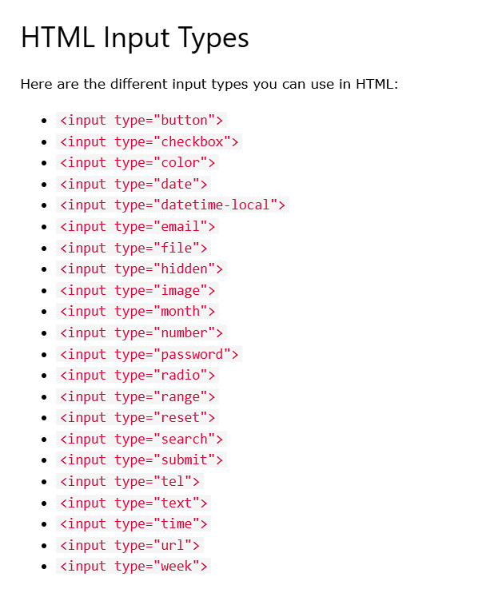

Slide 11
Thank You.
The End

